Slide 1

WIPRO NGA Program – 25SUB4505_5 G Developer
WIPRO NGA Program – 25SUB4505_5 G Developer
Capstone Project Presentation – 13th Feb 2026
Capstone Project Presentation – 13th Feb 2026
Project Title Here – 5G NR RLC ARQ Process
Project Title - Test 9: Physical Layer - HARQ Operation
Presented by – Group (03)
Presented by – Group (03)
www.rpsconsulting.in
www.rpsconsulting.in

Slide 2


PDCP LAYER
HARQ OPERATION
(Physical Layer)
Security and Header Compression
Hybrid Automatic Repeat Request in 5G New Radio
5G NR Protocol Stack Implementation
3GPP TS 38.321 | TS 38.214
2024 - RPS Consulting all rights reserved

Slide 3
What is HARQ ?
Hybrid Automatic Repeat Request (HARQ)
A core reliability mechanism in 5G NR that combines Forward Error Correction (FEC) with feedback-driven retransmissions to ensure robust data delivery over unreliable wireless channels.
→
Cross-Layer Operation
Integrates Physical Layer (TS 38.214) and MAC Layer (TS 38.321)
↻
Incremental Redundancy
Progressive parity injection instead of simple retransmission
⚡
Low Latency Design
Parallel HARQ processes enable continuous data flow
2024 - RPS Consulting all rights reserved

Slide 4
HARQ In 5G NR Protocol Architecture
WHY THIS ARCHITECTURE?
MAC Layer (TS 38.321)
✓
Parallel HARQ processes minimize idle time
• HARQ process allocation
• NDI management
• Feedback timing
• Retransmission control
✓
Asynchronous operation enables flexible scheduling
Physical Layer (TS 38.214)
✓
Supports eMBB, URLLC, and mMTC use cases
• Channel coding & rate matching
• RV selection
• Soft combining
✓
Maintains high throughput with low latency
• ACK/NACK generation
2024 - RPS Consulting all rights reserved
4

Slide 5
Physical Layer Overview
Layer 1 converts higher-layer data into radio signals and vice versa, handling transmission procedures, coding, modulation, and HARQ-related operations as specified in 3GPP TS 38.214.
◈
Channel Coding
◉
Modulation
▦
Resource Mapping
FEC encoding and rate matching
QPSK, 16QAM, 64QAM, 256QAM
Time-frequency allocation
↻
HARQ Procedures
⇄
Feedback Generation
◭
Flexible Numerology
RV selection & soft combining
ACK/NACK decision
Scalable subcarrier spacing
2024 - RPS Consulting all rights reserved

Slide 6
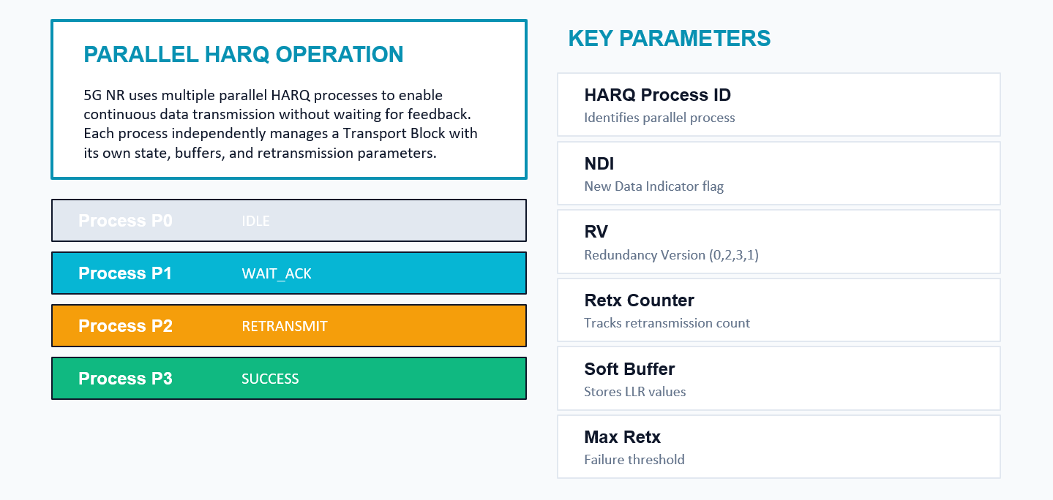
HARQ Process Architecture
Process P0
IDLE
Process P1
WAIT_ACK
Process P2
RETRANSMIT
Process P3
SUCCESS
2024 - RPS Consulting all rights reserved

Slide 7
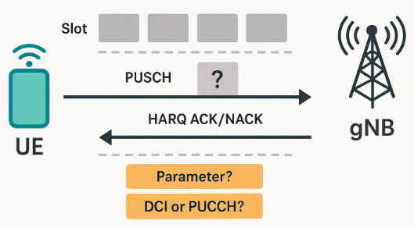
Process P0
IDLE
Process P1
WAIT_ACK
Process P2
RETRANSMIT
Process P3
SUCCESS
2024 - RPS Consulting all rights reserved

Slide 8
NDI : New Data Indicator
NDI acts as the identity switch for a HARQ process, distinguishing a new Transport Block from a retransmission of an earlier one.
NDI TOGGLED
NDI UNCHANGED
New Transport Block
• Receiver resets combining buffer
• Prepares to decode fresh data
• Process identity changes
• RV resets to 0
Retransmission
• Same Transport Block
• Receiver performs soft combining
• Merges with previous attempts
• RV increments for new parity
⚡ NDI ensures transmitter and receiver stay synchronized on data identity
2024 - RPS Consulting all rights reserved

Slide 9
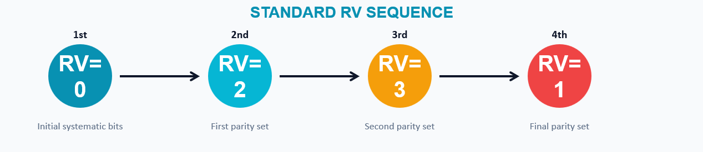
RV Cycling : Progressive Redundancy
The Redundancy Version (RV) controls which coded bits are transmitted in each HARQ attempt. Instead of repeating the same bits, the system progressively injects new parity information with every retransmission.
RV=0
RV=2
RV=3
RV=1
↻
Each retransmission adds NEW decoding information
⚡
No wasted bandwidth on blind repetition
✓
Progressive refinement increases success probability
2024 - RPS Consulting all rights reserved

Slide 10
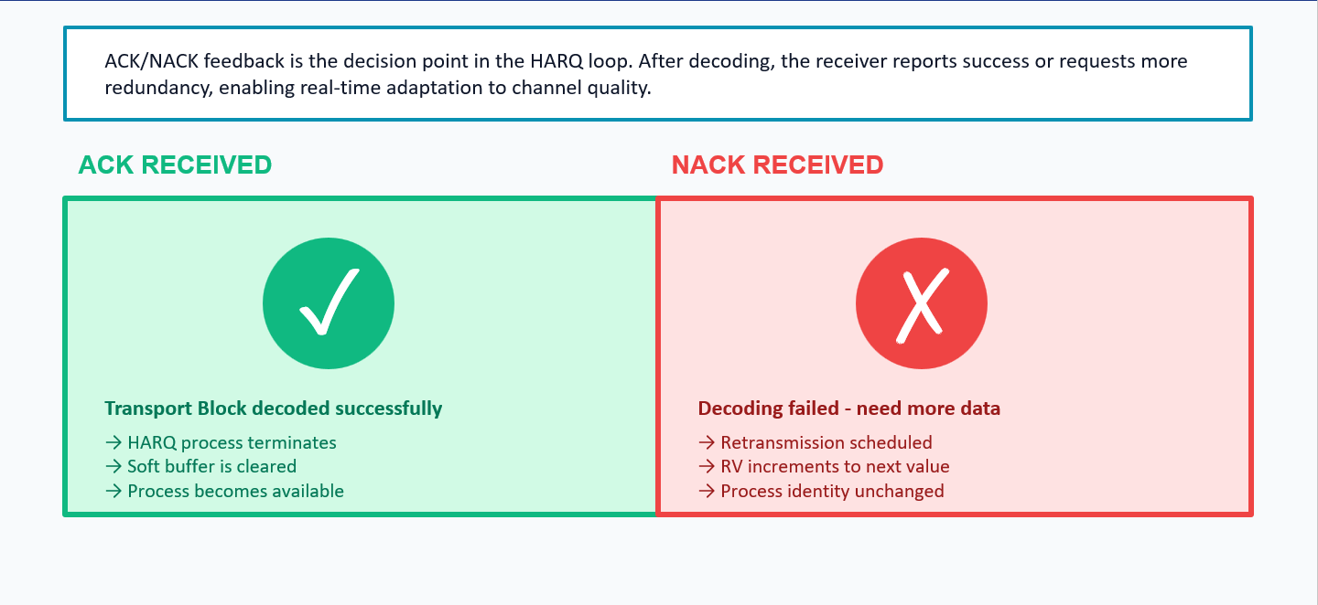
ACK/NACK : Closed – Loop Control
RV=0
RV=2
RV=3
RV=1
2024 - RPS Consulting all rights reserved

Slide 11
Soft Combining : Accumulating Reliability
Instead of discarding failed transmissions, the receiver stores probability-level information (Log-Likelihood Ratios) from each attempt and merges it with new information from retransmissions. With each combining step, confidence increases.
CONFIDENCE INCREASE WITH EACH RETRANSMISSION
Attempt 1
Attempt 2
Attempt 3
Attempt 4
40%
65%
85%
98%
• Each transmission contributes new knowledge
• Probability information accumulates in soft buffer
• Incremental redundancy ensures efficient use of retransmissions
2024 - RPS Consulting all rights reserved

Slide 12
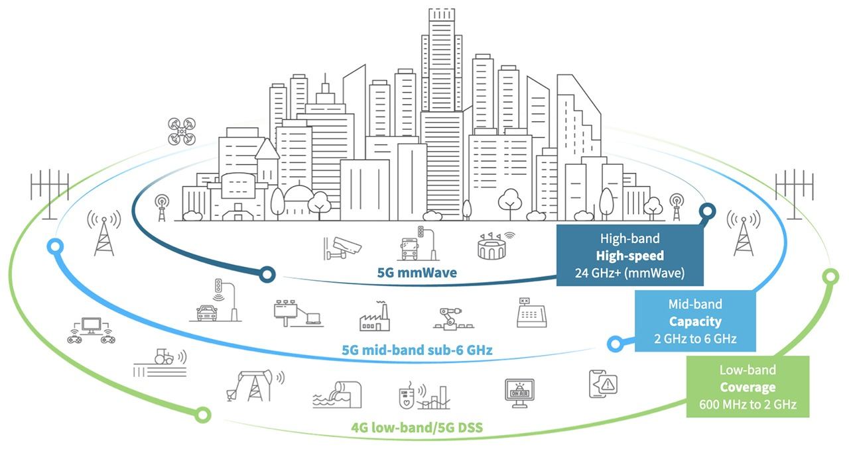
2024 - RPS Consulting all rights reserved

Slide 13
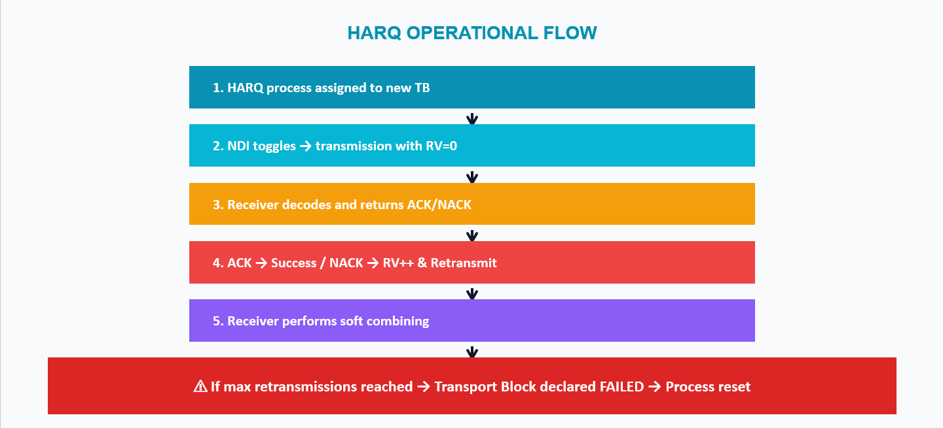
Retransmission Logic & Failure Resolution
2024 - RPS Consulting all rights reserved

Slide 14
Snippet
Code
Output
// HARQ Process Simulation - TS 38.321 §5.4
#include <iostream>
#include <vector>
#include <cstdint>
#include <string>
#include <array>
#include <random>
struct HARQProcess {
int id;
bool ndi = false; // New Data Indicator
int rv = 0; // Redundancy Version (0,2,3,1 cycle)
int retx_count = 0;
int max_retx = 4;
bool active = false;
std::string data;
static const std::array<int, 4> rv_sequence;
HARQ ID: 1
NDI: 0
RV: 0
Retx Count: 0
2024 - RPS Consulting all rights reserved

Slide 15
Snippet
Code
Output
void new_transmission(const std::string& d) {
data = d; ndi = !ndi; rv = 0; retx_count = 0; active = true;
std::cout << " HARQ[" << id << "] NEW TX: NDI=" << ndi
<< " RV=" << rv << " data=\"" << data << "\"\n";
}
bool retransmit() {
if (retx_count >= max_retx) {
std::cout << " HARQ[" << id << "] MAX RETX reached!\n";
active = false; return false;
}
retx_count++;
rv = rv_sequence[retx_count % 4];
std::cout << " HARQ[" << id << "] RETX #" << retx_count
<< ": RV=" << rv << "\n";
return true;
}
HARQ[1] NEW TX: NDI=1 RV=0 data="Hello"
HARQ[1] RETX #1: RV=2
HARQ[1] RETX #2: RV=3
HARQ[1] RETX #3: RV=1
HARQ[1] RETX #4: RV=0
HARQ[1] MAX RETX reached!
2024 - RPS Consulting all rights reserved

Slide 16
Snippet
Code
Output
void ack() {
std::cout << " HARQ[" << id << "] ACK received\n";
active = false;
}
};
const std::array<int, 4> HARQProcess::rv_sequence = {0, 2, 3, 1};
int main() {
std::cout << "=== HARQ Process (TS 38.321 §5.4) ===\n\n";
std::cout << "16 parallel stop-and-wait HARQ processes\n";
std::cout << "RV sequence: 0 -> 2 -> 3 -> 1\n\n";
std::mt19937 rng(42);
HARQProcess proc{0};
proc.new_transmission("PDU-DATA-A");
===HARQ Process (TS 38.321 §5.4) ==
16 parallel stop-and-wait HARQ processes
RV sequence: 0 -> 2 -> 3 -> 1
HARQ[0] NEW TX: NDI=1 RV=0 data="PDU-DATA-A"
2024 - RPS Consulting all rights reserved

Slide 17
Snippet
Code
Output
// Simulate NACK (channel error)
std::cout << " << NACK (CRC fail) >>\n";
proc.retransmit();
std::cout << " << NACK >>\n";
proc.retransmit();
std::cout << " << ACK (combining success) >>\n";
proc.ack();
std::cout << "\n";
proc.new_transmission("PDU-DATA-B");
std::cout << " << ACK (first attempt) >>\n";
proc.ack();
return 0;
}
=== HARQ Process (TS 38.321 §5.4) ===
16 parallel stop-and-wait HARQ processes
RV sequence: 0 -> 2 -> 3 -> 1
HARQ[0] NEW TX: NDI=1 RV=0 data="PDU-DATA-A"
<< NACK (CRC fail) >>
HARQ[0] RETX #1: RV=2
<< NACK >>
HARQ[0] RETX #2: RV=3
<< ACK (combining success) >>
HARQ[0] ACK received
HARQ[0] NEW TX: NDI=0 RV=0 data="PDU-DATA-B"
<< ACK (first attempt) >>
HARQ[0] ACK received
2024 - RPS Consulting all rights reserved

Slide 18
Output
=== HARQ Process (TS 38.321 §5.4) ===
16 parallel stop-and-wait HARQ processes
RV sequence: 0 -> 2 -> 3 -> 1
HARQ[0] NEW TX: NDI=1 RV=0 data="PDU-DATA-A"
<< NACK (CRC fail) >>
HARQ[0] RETX #1: RV=2
<< NACK >>
HARQ[0] RETX #2: RV=3
<< ACK (combining success) >>
HARQ[0] ACK received
HARQ[0] NEW TX: NDI=0 RV=0 data="PDU-DATA-B"
<< ACK (first attempt) >>
HARQ[0] ACK received
2024 - RPS Consulting all rights reserved

Slide 19
Key Concept Summary
HARQ
Transport Block (TB)
Reliability mechanism combining FEC with feedback-based retransmissions
Unit of data delivered from higher layers for transmission
HARQ Process
NDI
Independent transmission pipeline with unique ID and buffers
Flag distinguishing new TB from retransmission
Redundancy Version
ACK/NACK
Indicator for which coded bits are transmitted (0→2→3→1)
Receiver feedback controlling retransmissions
Soft Combining
Incremental Redundancy
Accumulating probability information across attempts
New parity per attempt, not repetition
Max Retx Limit
Threshold preventing indefinite retransmissions
2024 - RPS Consulting all rights reserved

Slide 20
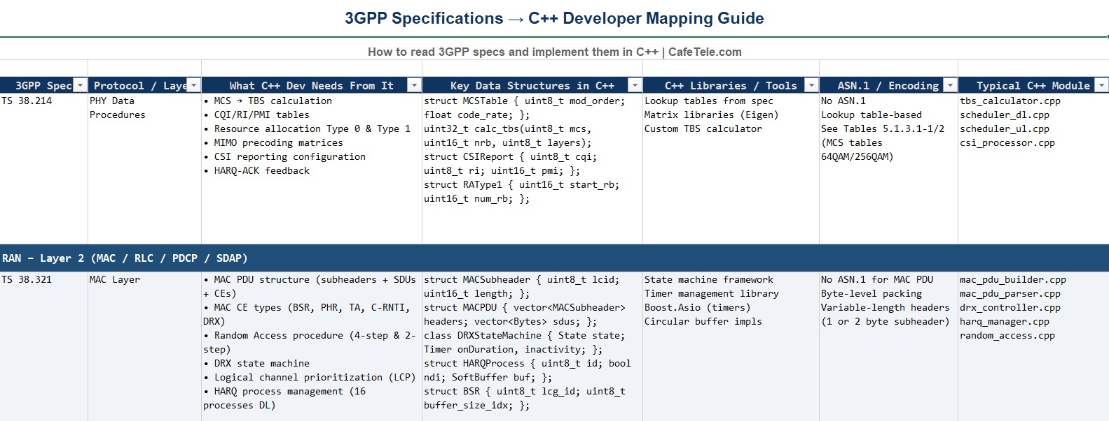
References
2024 - RPS Consulting all rights reserved

Slide 21
Conclusion
HARQ is a critical closed-loop reliability system in 5G NR that ensures robust data delivery without compromising latency or spectral efficiency.
✓ Combines Physical Layer transmission with MAC layer control
✓ Uses incremental redundancy and soft combining for efficiency
✓ Parallel processes enable continuous high-throughput operation
✓ Forms the foundation for eMBB, URLLC, and mMTC services
2024 - RPS Consulting all rights reserved

Slide 22
Thank You
                Presented By Group : 03
                1. Jayavarshini G
                2. Harshinie M
                3. Yuvaraj P
                4. Shreyash Bhatt
                5. Vikas Srivastava
2024 - RPS Consulting all rights reserved

